Slide 1
English 7-Chapter 8
Exercise 4
Combining Sentences by Inserting Words

Slide 2
This picture shows peanuts underground. They grow underground. (Add –ing.)
This picture shows peanuts growing underground.

Slide 3
Peanuts are a crop of many warm regions. They are a major crop.
Peanuts are a major crop of many warm regions.

Slide 4
Peanuts are a food for snacking. Peanuts are good for your health. (Add –ful.)
Peanuts are a food for healthful snacking.

Slide 5
The oil from peanuts is used in many dressings. The dressings are for salad.
The oil from peanuts is used in many salad dressings.

Slide 6
Grades of peanut oil are used to make soap and shampoo. The low grades are used for these products.
Low grades of peanut oil are used to make soap and shampoo.

Slide 7
Many countries grow peanuts solely for their oil. This oil is versatile.
Many countries grow peanuts solely for their versatile oil.

Slide 8
The peanut-producing countries include China, India, and the United States. These countries lead the world in peanut production. (Add -ing)
The leading peanut-producing countries include China, India, and the United States.

Slide 9
Some soils will stain the peanut shells. Dark soils are responsible for the stains.
Some dark soils will stain the peanut shells.

Slide 10
After peanuts are harvested, the plants are used for feed. The feed is for livestock.
After peanuts are harvested, the plants are used for livestock feed.

Slide 11
Peanuts are a good source of vitamins. Peanuts contain B vitamins.
Peanuts are a good source of B vitamins.

Slide 12
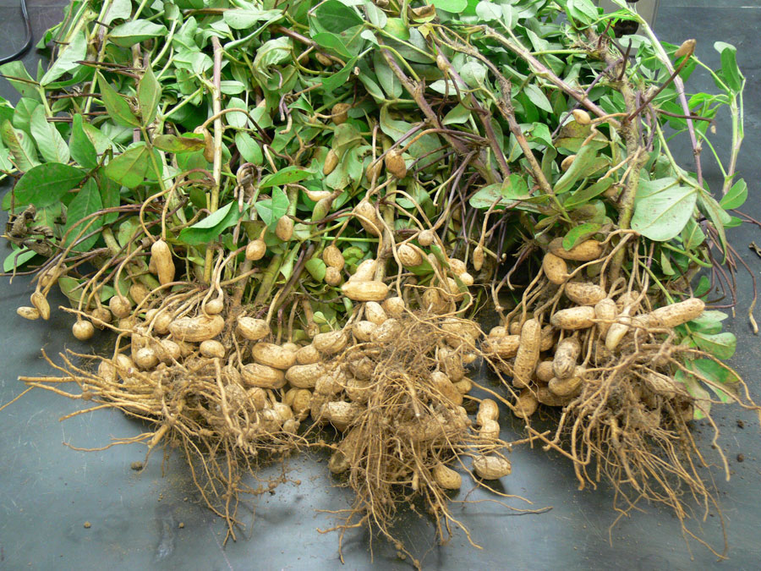
End

